Slide 1
Lesson plan Slide; NA Consider question, stress there are no right or wrong answers, take feedback Learning journey Share some explanations of creation, ask students to consider how far they align with their views TEACHER TALK explain information about Christian Fundamentalism Share scale of Biblical interpretation Students should record what they remember about interpretation Check answers TEACHER TALK link learning Refresh memory with video about creation Reflect on this and learning about Fundamentalism, answer questions Share answers Complete assessment Peer park section 1 of assessment
By the end of the lessons students need to know;
What Fundamental Christians believe about the Bible and the Creation account in Genesis 1
How different Christians interpret the Bible; conservative and liberal

Slide 2

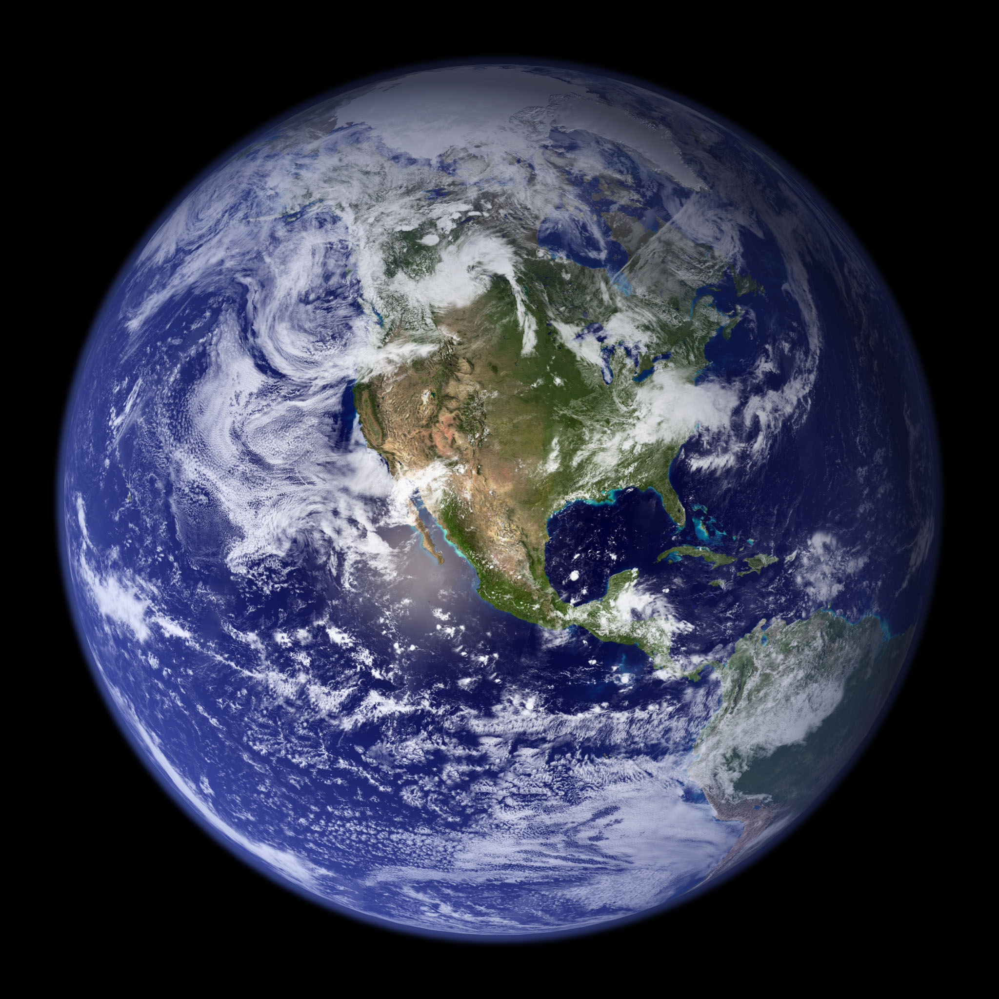
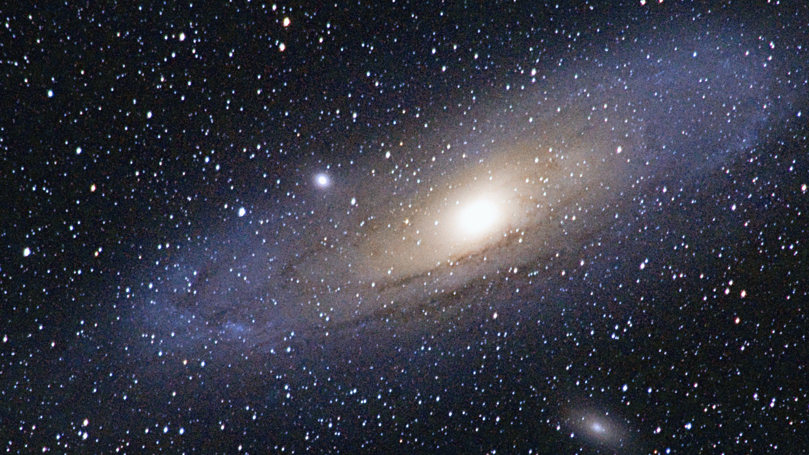

What do Fundamental Christians believe about creation?
How do you think the world came to exist?
Why do you think this? What is your reasoning?
Lesson question; What do Fundamental Christians believe about creation?
Topic question; Why don't all Christians express their religious tradition in the same way?

Slide 3












Unit 5 - Why don't all Christians express their religious tradition in the same way?
7. How are religion and politics connected in the USA? *
6. What do fundamental Christians believe about creation?
6
7
Core concepts
4. What is the history and development of the Amish?
Belief
4
Wisdom and authority
Community
5
2. What are the largest Christian groups in the USA?
5. Why is the Prosperity Gospel controversial?
2
3
How diverse is Christianity in the USA?
3. What is the history and development of the Church of Jesus Christ of Latter Day Saints?
1

Slide 4

What do Fundamental Christians believe about creation?
Throughout history people have developed explanations about how the world came into existence.
Do any of these align with your views?
Christian (Genesis Creation) In Genesis, God creates the world in six days and rests on the seventh. Humans are made in God’s image and given responsibility to care for the Earth. | Hindu Creation Hindu traditions have several creation stories. Some say the universe came from a cosmic egg or was created by Brahma. Many Hindus believe the universe goes through endless cycles of creation and destruction. | Scientific Explanation (Big Bang) Scientists believe the universe began about 13.8 billion years ago with the Big Bang. Over time, galaxies, stars, and planets formed, and life developed through evolution.
Ancient Norse Creation In Norse myth, the world began in an empty space called Ginnungagap between ice and fire. From this came the giant Ymir, whose body the gods later used to create the world. | Ancient Egyptian Creation Ancient Egyptians believed the world began in watery chaos. A creator god, such as Atum or Ra, emerged and created the other gods, the land, and humans. | Aboriginal Australian Creation In Aboriginal traditions, ancestral spirits in the Dreaming travelled across the land, creating rivers, mountains, animals, and people while shaping how people should live.
Lesson question; What do Fundamental Christians believe about creation?
Topic question; Why don't all Christians express their religious tradition in the same way?

Slide 5

What do Fundamental Christians believe about creation?
Today we are going to think about a specific branch of Christian belief and interpretation, and how this impacts beliefs about the creation of the world.
What is Christian Fundamentalism?
Some Christians believe the Bible should be taken literally.
These Christians are often called fundamentalists.
They believe:
The Bible is the direct word of God.
Everything in the Bible is completely true and accurate.
It should be understood exactly as it is written, not as a symbol or metaphor.
Lesson question; What do Fundamental Christians believe about creation?
Topic question; Why don't all Christians express their religious tradition in the same way?

Slide 6


What do Fundamental Christians believe about creation?
Beliefs about how the Bible should be understood and interpreted vary in Christianity.
Fundamentalist (Literal) The Bible is the direct word of God and is completely true. It should be understood exactly as it is written. Events in the Bible happened exactly as described. | Conservative The Bible is inspired by God and very important for Christian belief. Most teachings are believed to be historically true, but some parts may use symbolism or poetic language. Scientific ideas maybe accepted alongside this. | Liberal The Bible is a collection of writings by people about their experiences of God. Many stories are understood as symbolic or metaphorical, rather than literal history. The moral and spiritual message is more important than whether every detail is true.
Lesson question; What do Fundamental Christians believe about creation?
Topic question; Why don't all Christians express their religious tradition in the same way?

Slide 7

What do Fundamental Christians believe about creation?
How does each Christian group understand and interpret the Bible?
Fundamentalist (Literal) The Bible is the direct word of God and is completely true. It should be understood exactly as it is written. Events in the Bible happened exactly as described. | Conservative The Bible is inspired by God and very important for Christian belief. Most teachings are believed to be historically true, but some parts may use symbolism or poetic language. Scientific ideas maybe accepted alongside this. | Liberal The Bible is a collection of writings by people about their experiences of God. Many stories are understood as symbolic or metaphorical, rather than literal history. The moral and spiritual message is more important than whether every detail is true.
Lesson question; What do Fundamental Christians believe about creation?
Topic question; Why don't all Christians express their religious tradition in the same way?

Slide 8

What do Fundamental Christians believe about creation?
Fundamentalist (Literal) The Bible is the direct word of God and is completely true. It should be understood exactly as it is written. Events in the Bible happened exactly as described. | Conservative The Bible is inspired by God and very important for Christian belief. Most teachings are believed to be historically true, but some parts may use symbolism or poetic language. Scientific ideas maybe accepted alongside this. | Liberal The Bible is a collection of writings by people about their experiences of God. Many stories are understood as symbolic or metaphorical, rather than literal history. The moral and spiritual message is more important than whether every detail is true.
Lesson question; What do Fundamental Christians believe about creation?
Topic question; Why don't all Christians express their religious tradition in the same way?

Slide 9
What do Fundamental Christians believe about creation?
So, if Fundamental Christians have a literal understanding of the Bible, what do they believe about the creation account?
Let’s refresh our memory about what happens in the Biblical creation account first.
Lesson question; What do Fundamental Christians believe about creation?
Topic question; Why don't all Christians express their religious tradition in the same way?

Slide 10
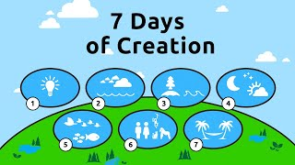
What do Fundamental Christians believe about creation?
Lesson question; What do Fundamental Christians believe about creation?
Topic question; Why don't all Christians express their religious tradition in the same way?

Slide 11

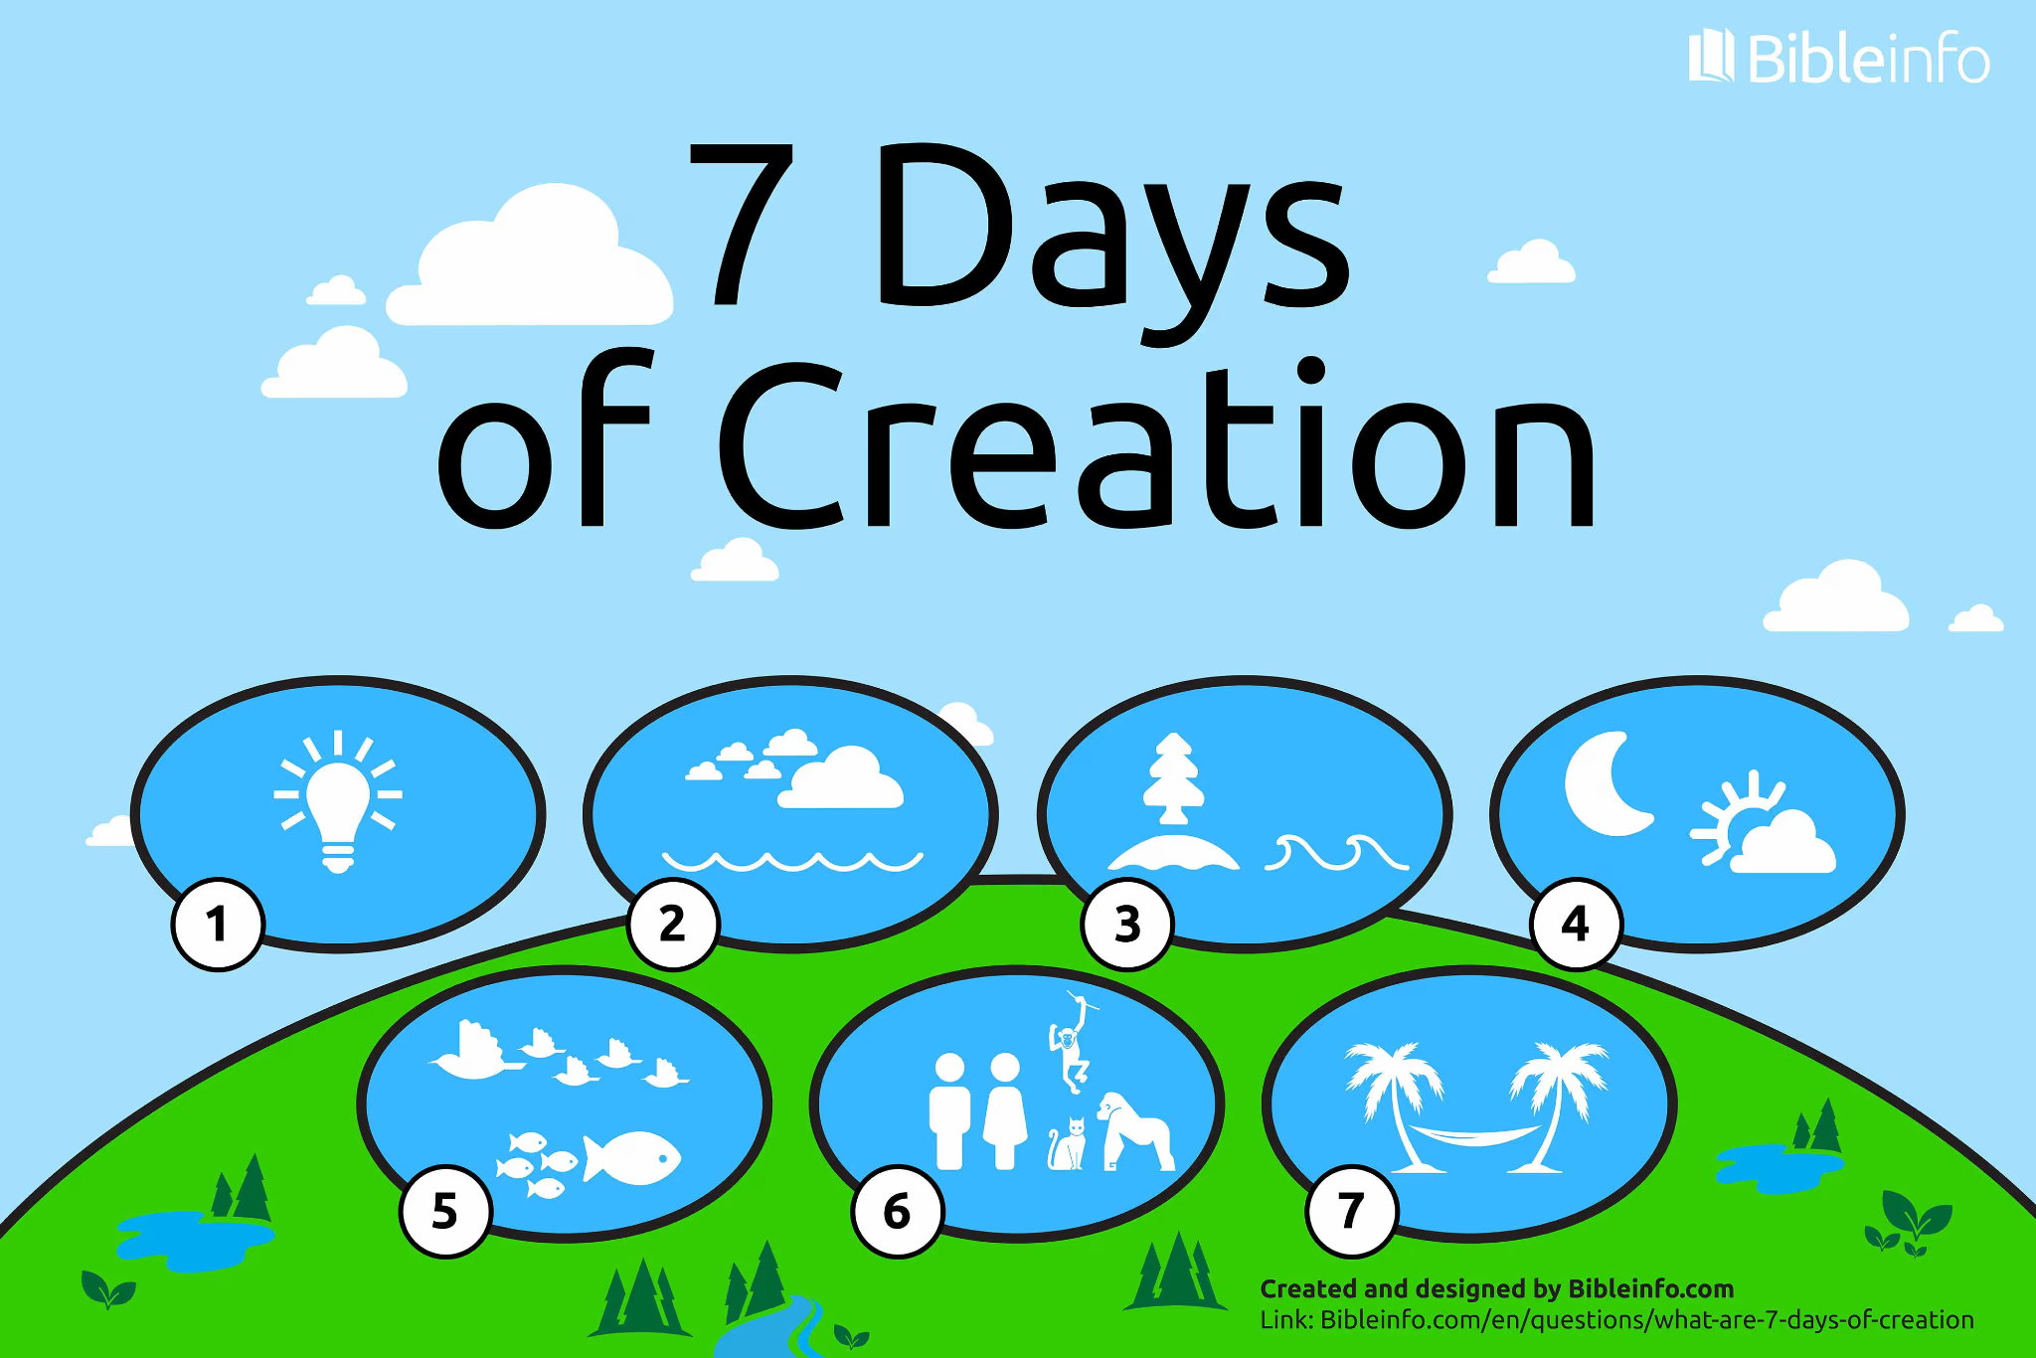
What do Fundamental Christians believe about creation?
How would Fundamental Christians understand this account?
What does it show about God?
How does it compare to the way in which Liberal Christians would understand this account?
Lesson question; What do Fundamental Christians believe about creation?
Topic question; Why don't all Christians express their religious tradition in the same way?

Slide 12
What do Fundamental Christians believe about creation?
How would Fundamental Christians understand this account?
Fundamental Christians believe Genesis 1 is a literal and historically accurate description of how God created the world. God created everything in six actual days, exactly as the Bible describes.
What does it show about God?
God is the ultimate creator behind the universe.
How does it compare to the way in which Liberal Christians would understand this account?
Liberal Christians usually see Genesis 1 as symbolic or poetic, not a scientific explanation. It teaches religious truths about God and creation, rather than describing exactly how the universe formed.
Lesson question; What do Fundamental Christians believe about creation?
Topic question; Why don't all Christians express their religious tradition in the same way?

Slide 13

What do Fundamental Christians believe about creation?
Assessment;
Answer all the questions to the best of your ability.
You have 20 minutes.
Use the success criteria and sentence starters to help you.
There are questions about everything we have studied so far this year, and you can use any learning from this year in your extended writing answers.
Lesson question; What do Fundamental Christians believe about creation?
Topic question; Why don't all Christians express their religious tradition in the same way?
Lesson question; What do Fundamental Christians believe about creation?
Topic question; Why don't all Christians express their religious tradition in the same way?

Slide 14

What do Fundamental Christians believe about creation?
B 7 dimensions of religion
D Dharma
C Vishnu
A Animal
C Diaspora
B Shema
B Antisemitism
B Torah
A Russian
B Believers Baptism
Lesson question; What do Fundamental Christians believe about creation?
Topic question; Why don't all Christians express their religious tradition in the same way?

